Slide 1

Agile Presentation
By: Ryne Williams

Slide 2

Scrum Agile Team roles
Scrum Master – The Scrum Master is the person who leads the team and ensures that everyone is on track with their tasks during each Sprint. They also plan and lead the daily stand-ups, weekly Scrum meetings, and Sprint Retrospectives. Though the Scrum Master is the primary leader of the Scrum team, they are not in charge of anyone, and play more the role of a facilitator and advisor to the team.
Product Owner – The Product Owner is the direct line of communication between the Scrum team and the client/upper management. The Product Owner spends most of their time getting information from the client on details regarding their product and programs. And setting up the backlog for the development team. Their main goal is to ensure that the Scrum team aligns with the overall product goal.
Development Team – This is usually composed of developers and testers, in most cases. This is the part of the Scrum team that does most of the hands-on work and project development. They help with project planning and use their knowledge to design and help improve on the product being developed.

Slide 3
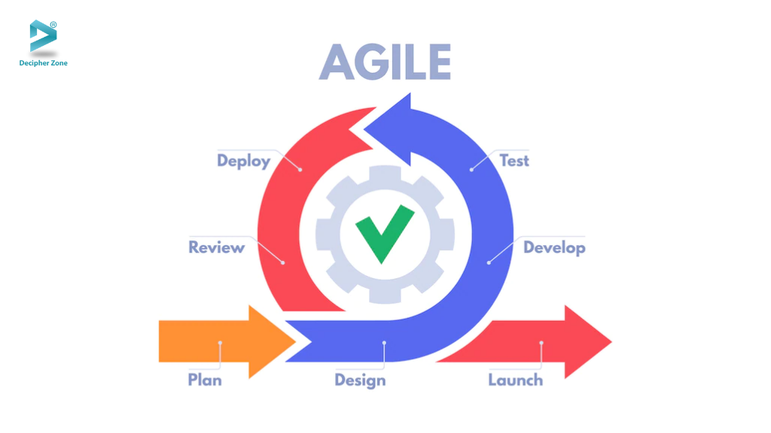
SDLC and the Agile approach
Planning – The client and Product Owner discuss what the software to be developed will achieve. The Product Owner then organizes the functions of the system and communicates them to the team.
Design – During the design phase the development team will determine the best way to develop the software as quickly and efficiently as possible according to the requirements the Product Owner documented. This involves setting up the priority of each user requirement and determining the backlog.
Develop – When beginning the development phase, the agile team begins with Sprint meetings to determine the tasks to complete during that sprint, which includes daily standup meetings. The Scrum Master leads and facilitates these meetings to ensure the team stays focused.
Test – While the software is being developed, the testers will test the functionality of the software as it is being built to ensure that the team does not go into the next sprint with code that does not provide the proper functionality.
Deploy – Once the software or system has been completed and fully tested, it is handed over to the client for review and implementation. The development team stays in touch to ensure that any lingering issues are quickly resolved.
Review – Once the software has been completed, the development team presents a review of the implementation and maintenance of the software against the requirements to the client to show that the desired results have been achieved.

Slide 4
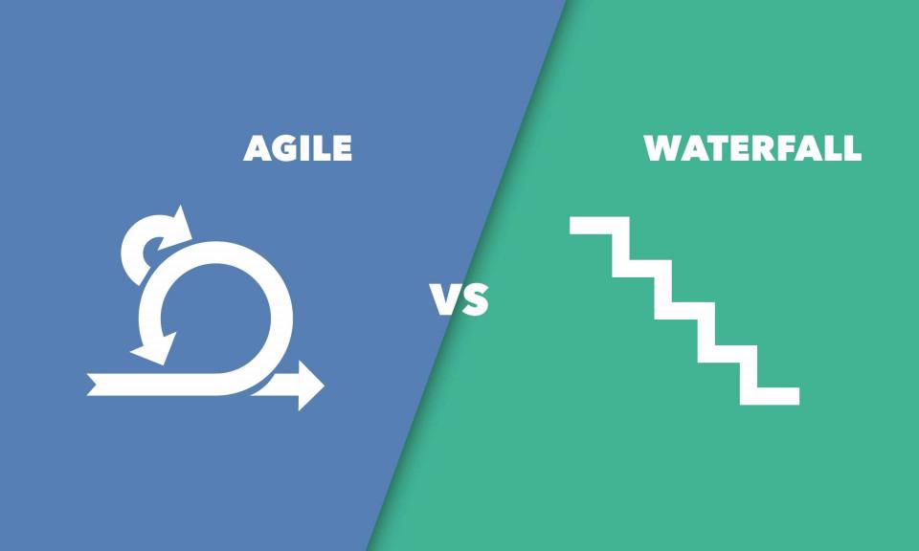
Waterfall approach, what if?
If this project had been done within the waterfall model, the outcome would have been much different. If there were any issues in the coding, it would not be found until after all coding was done and testing started at the end of the process. Also, with the sudden change in direction from the client, most of the project, if not all of it, would have had to start from scratch or reworked to accommodate the new requirements.

Slide 5

Agile or Waterfall
When deciding whether to go with agile or waterfall for a project, there are quite a few details and aspects to take into consideration to ensure that you choose the best path for the project ahead. One of the most important is to consider the level of complexity that is inherent in the project and how much is known versus unknown. The more you know about the project, and the less complex it is, the more likely that a waterfall approach would be more beneficial to your project. However, the higher the level of complexity, and the more that is unknown from the start, the more likely that an agile approach would be the most efficient option. Though, having a mixture of the two, depending on the application, could also provide the benefits of both to the project being developed.

Slide 6

References
Coursera (2022), The 3 Scrum Roles and Responsibilities Explained, https://www.coursera.org/articles/scrum-roles-and-responsibilities
Dzuiba, A., (2022), Agile Software Development Lifecycle Phases Explained, https://relevant.software/blog/agile-software-development-lifecycle-phases-explained/#Requirements
Lotz, M., (2018), Waterfall vs. Agile: Which is the Right Development Methodology for Your Project?, https://www.seguetech.com/waterfall-vs-agile-methodology/

